Slide 1

Presented by:
Aditya Kumar
Aman Choudhary
Mahesh Kumar
Palaparthi Govindu
Vivek Attupurath

Slide 2
AIM
To increase the availability of distributed system by trading some consistency which is considered tolerable in practical scenarios so as to facilitate scaling.
This paper introduces BASE – an alternative for ACID
As a part of this paper, we will see different methods to:
keep up with consistency without 2PC
deal with inconsistency issues that arise when we don’t use 2PC
Make operations idempotent
Provide assurance of ordering

Slide 3
Our aim
To build web applications that can acquire broad adoption
Side effect
Transactional growth
Challenge
Data storage and computational power
Solution
Distributed systems
Issue
Availability-Consistency trade-off
Suggestion
BASE

Slide 4
Scaling: Vertical vs Horizontal

Slide 5
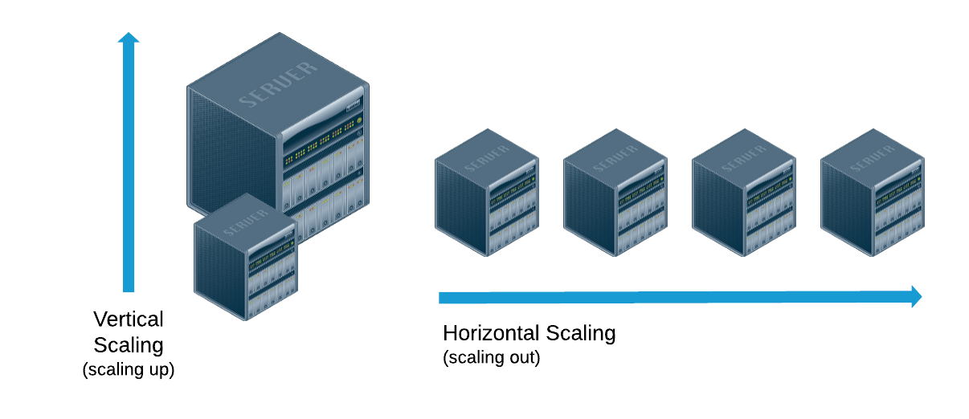

Slide 6
Vertical scaling (Scaling up)
Horizontal scaling (Scaling out)
Scaling by adding more power (CPU, RAM etc)
Easier to implement as logic need not be altered. (Just run same code on machines with higher specifications)
Data lives on single node and scaling is done through multicore
Higher downtime required for scaling
Concurrent programming done using Message passing is easier due to shared address space (Data sharing/message sharing can be done by passing a reference)
Scaling by adding more machines
Tougher to implement
Each node contains part of data
Lesser downtime required for scaling
Jobs can be distributed across networks (Eg: Map reduce)
Data sharing is complex and costly

Slide 7
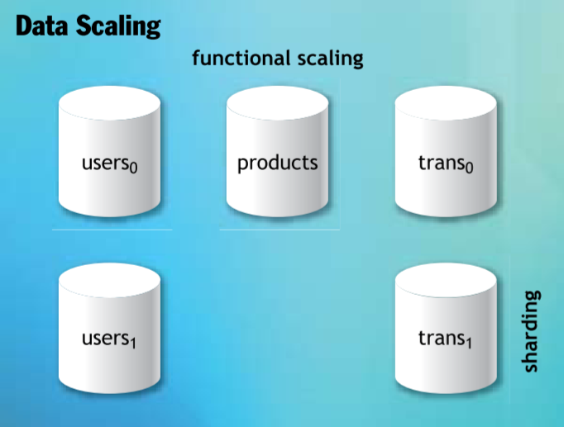
2 Dimensions of Horizontal Scaling
Functional scaling
Grouping data by function and spreading functional groups across databases
Sharding
Splitting data within functional areas across multiple databases

Slide 8
CAP Theorem
It is impossible for a distributed system to simultaneously provide more than two out of the below 3 guarantees:
Consistency
Availability
Partition tolerance

Slide 9
Consistency
Any read operation (on any node) that begins after the completion of a write operation must return that value, or the result of a later write operation
Read or write from/to any node and get the same data
Availability
Ability to access the cluster even if a node in the cluster goes down
Every request received by a non-failing node in the system must result in a response.
The server is not allowed to ignore the client’s requests
Partition tolerance
Cluster continues to function even if there is a "partition" (communication break) between two nodes (both nodes are up, but can't communicate)
The system continues to operate despite an arbitrary number of messages being dropped(or delayed) by the network between nodes

Slide 10
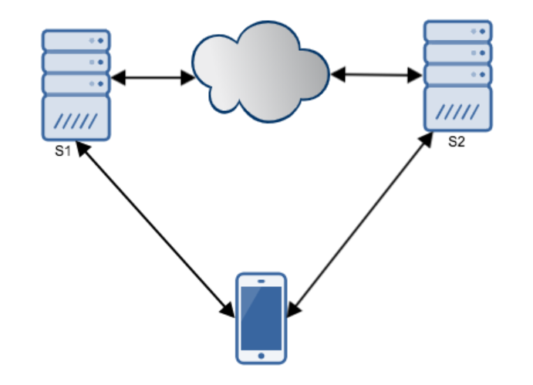
Why does CAP theorem hold true?
All distributed system needs partition tolerance. For a distributed (i.e., multi-node) system to not require partition-tolerance it will have to run on a network which is guaranteed to never drop messages (or even deliver them late) and whose nodes are guaranteed to never die.
Suppose we have a very simple distributed system with only two servers S1 and S2. Let us assume that partition tolerance holds.
Suppose there is network failure. Since our system is partition tolerant it is supposed to work. During the network failure client sends a write request to server S1.

Slide 11
If the system is consistent:
S1 must update S2 before confirming to the client
S1 cannot update S2 (Network failure)
Request to S1 will timeout
No availability
If the system is available:
S1 will respond to the client without waiting for an update in S2
If any client makes a read request to S2 for the same information it will receive older value not the result of recent write
No consistency

Slide 12
Key Takeaway
Distributed Databases helps to Scale

Slide 13
Remember ACID properties?
Transaction: Grouping of Logical operations into a single unit.
ACID Property: Ensures Integrity to a Transaction.
ACID:
Atomic: all or nothing property. Either all operations in a transaction succeed or the completed is rolled back.
Consistent: On the completion of a transaction, the database is structurally sound.
Isolated: Ensures that multiple transactions can occur concurrently without making the state of database inconsistent.
Durable: The results after a transaction are permanent, even in the presence of failures.

Slide 14
How to maintain
ACID Properties in
Distributed database systems?

Slide 15
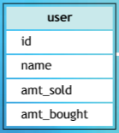
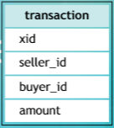
Non-distributed case
Begin transaction
Insert into transactions(xid, seller_id, buyer_id, amount);
Update user set amt_sold = amt_sold +$amount where id=$seller_id;
Update user set amt_bought= amount_bought+$amount where id=$buyer_id;
End transaction
DB

Slide 16
Non-distributed case
Begin transaction
Insert into transactions(xid, seller_id, buyer_id, amount);
Update user set amt_sold = amt_sold +$amount where id=$seller_id;
Update user set amt_bought= amount_bought+$amount where id=$buyer_id;
End transaction
DB
Distributed case
Begin transaction
Insert into transactions(xid, seller_id, buyer_id, amount);
Update user set amt_sold = amt_sold + $amount where id=$seller_id;
Update user set amt_bought= amt_bought + $amount where id=$buyer_id;
End transaction
User
Transactions

Slide 17
Consistency not guaranteed.
Distributed case
ACID:
Atomic
all or nothing property. Either all operations in a transaction succeed or the completed is rolled back.
Consistent
On the completion of a transaction, the database is structurally sound.
Isolated
Ensures that multiple transactions can occur concurrently without making the state of database inconsistent.
Durable
The results after a transaction are permanent, even in the presence of failures.
Begin transaction
Insert into transactions(xid, seller_id, buyer_id, amount);
Update user set amt_sold = amt_sold + $amount where id=$seller_id;
Update user set amt_bought= amt_bought + $amount where id=$buyer_id;
End transaction
User
Transactions

Slide 18
Consistency in Distributed Databases? 2PC

Slide 19
What is 2PC?
2PC (2 Phase Commit) Phases
Prepare Phase (Voting process)
Commit Phase
Transaction Coordinator

Slide 20
Example 1: Distributed Transaction using 2PC

Slide 21


User
Transaction
Database Interface
Tx Coordinator

Slide 22
User
Transaction
Database Interface
Tx Coordinator
Begin transaction
Insert into transaction (xid, seller_id, buyer_id, amount);
Update user set amt_sold = amt_sold +$amount where id=$seller_id;
Update user set amt_bought= amount_bought+$amount where id=$buyer_id;
End transaction

Slide 23

User
Transaction
Database Interface
Tx Coordinator
Begin transaction
Insert into transaction (xid, seller_id, buyer_id, amount);
Update user set amt_sold = amt_sold +$amount where id=$seller_id;
Update user set amt_bought= amount_bought+$amount where id=$buyer_id;
End transaction

Slide 24
User
Transaction
Database Interface
Tx Coordinator
Begin transaction
Insert into transaction (xid, seller_id, buyer_id, amount);
Update user set amt_sold = amt_sold +$amount where id=$seller_id;
Update user set amt_bought= amount_bought+$amount where id=$buyer_id;
End transaction

Slide 25
User
Transaction
Database Interface
Tx Coordinator
Begin transaction
Insert into transaction (xid, seller_id, buyer_id, amount);
Update user set amt_sold = amt_sold +$amount where id=$seller_id;
Update user set amt_bought= amount_bought+$amount where id=$buyer_id;
End transaction

Slide 26
Problem with 2PC: Reduces Availability

Slide 27
User
Transaction
Database Interface
Tx Coordinator

Slide 28
User
Transaction
Database Interface
Tx Coordinator
Begin transaction
Insert into transaction (xid, seller_id, buyer_id, amount);
Update user set amt_sold = amt_sold +$amount where id=$seller_id;
Update user set amt_bought= amount_bought+$amount where id=$buyer_id;
End transaction

Slide 29
User
Transaction
Database Interface
Tx Coordinator
Begin transaction
Insert into transaction (xid, seller_id, buyer_id, amount);
Update user set amt_sold = amt_sold +$amount where id=$seller_id;
Update user set amt_bought= amount_bought+$amount where id=$buyer_id;
End transaction

Slide 30
User
Transaction
Database Interface
Tx Coordinator
Begin transaction
Insert into transaction (xid, seller_id, buyer_id, amount);
Update user set amt_sold = amt_sold +$amount where id=$seller_id;
Update user set amt_bought= amount_bought+$amount where id=$buyer_id;
End transaction

Slide 31
User
Transaction
Could not process transaction!
Database Interface
Tx Coordinator
Availability is LOST.
Begin transaction
Insert into transaction (xid, seller_id, buyer_id, amount);
Update user set amt_sold = amt_sold +$amount where id=$seller_id;
Update user set amt_bought= amount_bought+$amount where id=$buyer_id;
End transaction

Slide 32
User
Transaction
Could not process transaction!
Consistent
Not Available
Partition Tolerant
Database Interface
Tx Coordinator
Request Timed Out
Begin transaction
Insert into transaction (xid, seller_id, buyer_id, amount);
Update user set amt_sold = amt_sold +$amount where id=$seller_id;
Update user set amt_bought= amount_bought+$amount where id=$buyer_id;
End transaction

Slide 33
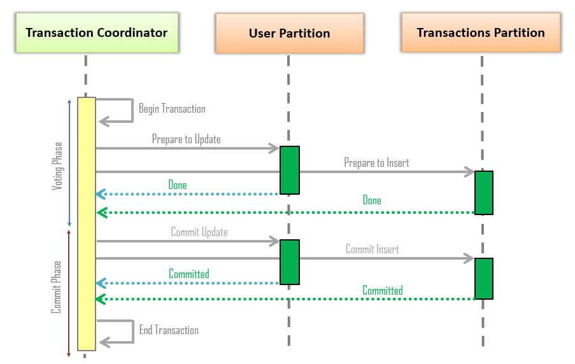
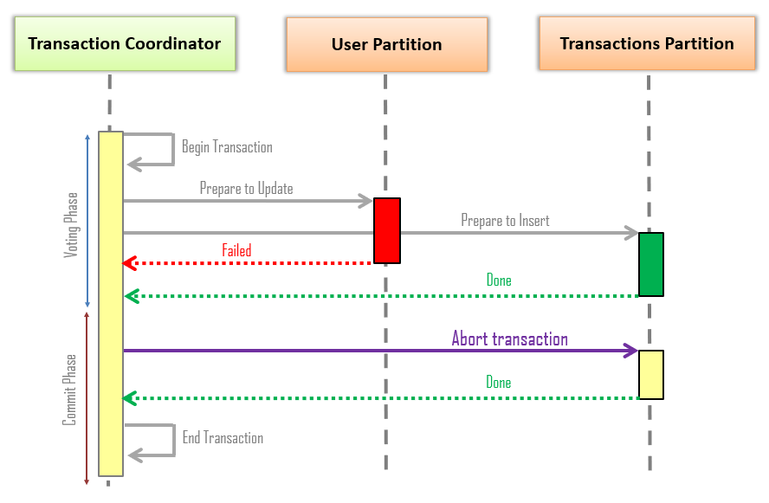
2PC–An Illustration
(i) Successful 2PC (ii) Unsuccessful 2PC
Disadvantages of 2PC
Loss of Availability
It is a blocking protocol, introduces delays.
Too many failure points

Slide 34
Consistency Availability
To guarantee consistency using 2PC, we lose Availability.
What is our alternative?

Slide 35
Consistency Availability
To guarantee consistency using 2PC, we lose Availability.
What is our alternative?
BASE

Slide 36
Increasing Availability:
BASE

Slide 37
BASE-An ACID Alternative
BASE is diametrically opposed to ACID.
BASE
Basically Available: This constraint states that the system does guarantee the availability of the data as regards CAP Theorem; there will be a response to any request. But that response could still be ‘failure’ to obtain the requested data, or the data may be in an inconsistent or changing state, much like waiting for a check to clear in your bank account.
Soft state: The state of the system could change over time, so even during times without input there may be changes going on due to ‘eventual consistency,’ thus the state of the system is always ‘soft.’
Eventual consistency: The system will eventually become consistent once it stops receiving input. The data will propagate to everywhere it should sooner or later, but the system will continue to receive input and is not checking the consistency of every transaction before it moves onto the next one.

Slide 38
Relaxing Consistency
The total bought/sold amount columns in the user table can be considered a cache of the transaction table.
Updating them immediately in the user table may not be necessary.
With an appropriate contract, the end user may only expect an estimate of her the total bought/sold amount.

Slide 39
Begin transaction
Insert into transaction (xid, seller_id, buyer_id, amount);
Update user set amt_sold = amt_sold +$amount where id=$seller_id;
Update user set amt_bought= amount_bought+$amount where id=$buyer_id;
End transaction
Begin transaction
Insert into transaction (xid, seller_id, buyer_id, amount);
End transaction
Begin transaction
Update user set amt_sold = amt_sold +$amount where id=$seller_id;
Update user set amt_bought= amount_bought+$amount where id=$buyer_id;
End transaction

Slide 40
User
Transaction
Database Interface
Tx Coordinator

Slide 41
User
Transaction
Database Interface
Tx Coordinator
Begin transaction
Insert into transaction (xid, seller_id, buyer_id, amount);
End transaction
Begin transaction
Update user set amt_sold = amt_sold +$amount where id=$seller_id;
Update user set amt_bought= amount_bought+$amount where id=$buyer_id;
End transaction

Slide 42
User
Transaction
Begin transaction
Update user set amt_sold = amt_sold +$amount where id=$seller_id;
Update user set amt_bought= amount_bought+$amount where id=$buyer_id;
End transaction
Begin transaction
Insert into transaction (xid, seller_id, buyer_id, amount);
End transaction
Database Interface
Tx Coordinator

Slide 43
T1, A, B, 100
User
Transaction
Begin transaction
Insert into transaction (xid, seller_id, buyer_id, amount);
End transaction
Database Interface
Tx Coordinator

Slide 44
U1, A, 100, 0
T1, A, B, 100
U2, B, 0, 100
User
Transaction
Begin transaction
Update user set amt_sold = amt_sold +$amount where id=$seller_id;
Update user set amt_bought= amount_bought+$amount where id=$buyer_id;
End transaction
Database Interface
Tx Coordinator

Slide 45
Begin transaction
Insert into transaction (xid, seller_id, buyer_id, amount);
End transaction
Begin transaction
Update user set amt_sold = amt_sold +$amount where id=$seller_id;
Update user set amt_bought= amount_bought+$amount where id=$buyer_id;
End transaction

Slide 46
U1, A, 0, 0
Lost update
T1, A, B, 100
U2, B, 0, 0
User
Transaction
Database Interface
Tx Coordinator
Available
Partition Tolerant
Not even Eventual Consistent (Permanently Inconsistent)

Slide 47
Decoupling Transactions introduces permanent inconsistency:
What can be done?

Slide 48
Decoupling Transactions introduces permanent inconsistency:
What can be done?
Persistent Message Queues

Slide 49
Begin transaction
Insert into transaction (xid, seller_id, buyer_id, amount);
End transaction
Begin transaction
Update user set amt_sold = amt_sold +$amount where id=$seller_id;
Update user set amt_bought= amount_bought+$amount where id=$buyer_id;
End transaction
Begin transaction
Insert into transaction(id, seller_id, buyer_id, amount);
Queue message “update user(“seller”, seller_id, amount)”;
Queue message “update user(“buyer”, buyer_id, amount)”;
End transaction
For each message in queue
Begin transaction
Dequeue message
If message.type == “seller”
Update user set amt_sold = amt_sold + message.amount where id=message.id;
Else
Update user set amt_bought= amt_bought + message.amount where id=message.id;
End if
End transaction
End for

Slide 50
Queue on the same DB, to avoid 2PC
User
Transaction
Queue
Begin transaction
Insert into transaction(id, seller_id, buyer_id, amount);
Queue message “update user(“seller”, seller_id, amount)”;
Queue message “update user(“buyer”, buyer_id, amount)”;
End transaction
Database Interface
Tx Coordinator
For each message in queue
Begin transaction
Dequeue message
If message.type == “seller”
Update user set amt_sold = amt_sold + message.amount where id=message.id;
Else
Update user set amt_bought= amt_bought + message.amount where id=message.id;
End if
End transaction
End for

Slide 51
T1, A, B, 100
Updates are captured in queue.
Update A
Update B
User
Transaction
Queue
Begin transaction
Insert into transaction(id, seller_id, buyer_id, amount);
Queue message “update user(“seller”, seller_id, amount)”;
Queue message “update user(“buyer”, buyer_id, amount)”;
End transaction
Database Interface
Tx Coordinator

Slide 52
U1, A, 100, 0
T1, A, B, 100
U2, B, 0, 100
Update A
Update B
User
Transaction
Queue
Database Interface
Messages are processed in background.
Tx Coordinator
For each message in queue
Begin transaction
Dequeue message
If message.type == “seller”
Update user set amt_sold = amt_sold + message.amount where id=message.id;
Else
Update user set amt_bought= amt_bought + message.amount where id=message.id;
End if
End transaction
End for

Slide 53
U1, A, 100, 0
T1, A, B, 100
U2, B, 0, 100
Update A
Update B
User
Transaction
Queue
Database Interface
Partition Tolerant
Available (Not yet)
Eventually Consistent
Soft State
Tx Coordinator

Slide 54
Why is it not fully available? We still have 2PC!

Slide 55
User
Transaction
Queue
Database Interface
Begin transaction
Insert into transaction(id, seller_id, buyer_id, amount);
Queue message “update user(“seller”, seller_id, amount)”;
Queue message “update user(“buyer”, buyer_id, amount)”;
End transaction
For each message in queue
Begin transaction
Dequeue message
If message.type == “seller”
Update user set amt_sold = amt_sold + message.amount where id=message.id;
Else
Update user set amt_bought= amt_bought + message.amount where id=message.id;
End if
End transaction
End for
Tx Coordinator

Slide 56
User
Transaction
Queue
Database Interface
Begin transaction
Insert into transaction(id, seller_id, buyer_id, amount);
Queue message “update user(“seller”, seller_id, amount)”;
Queue message “update user(“buyer”, buyer_id, amount)”;
End transaction
For each message in queue
Begin transaction
Dequeue message
If message.type == “seller”
Update user set amt_sold = amt_sold + message.amount where id=message.id;
Else
Update user set amt_bought= amt_bought + message.amount where id=message.id;
End if
End transaction
End for
Tx Coordinator

Slide 57
Avoiding 2PC: What can be done?

Slide 58
Avoiding 2PC:
Solution1:
Do Nothing. ☺

Slide 59
User
Transaction
Queue
Begin transaction
Insert into transaction(id, seller_id, buyer_id, amount);
Queue message “update user(“seller”, seller_id, amount)”;
Queue message “update user(“buyer”, buyer_id, amount)”;
End transaction
User facing component is not affected.
For each message in queue
Begin transaction
Dequeue message
If message.type == “seller”
Update user set amt_sold = amt_sold + message.amount where id=message.id;
Else
Update user set amt_bought= amt_bought + message.amount where id=message.id;
End if
End transaction
End for

Slide 60
User
Transaction
Queue
Begin transaction
Insert into transaction(id, seller_id, buyer_id, amount);
Queue message “update user(“seller”, seller_id, amount)”;
Queue message “update user(“buyer”, buyer_id, amount)”;
End transaction
For each message in queue
Begin transaction
Dequeue message
If message.type == “seller”
Update user set amt_sold = amt_sold + message.amount where id=message.id;
Else
Update user set amt_bought= amt_bought + message.amount where id=message.id;
End if
End transaction
End for
Due to 2PC, background component which processes messages looses availability.

Slide 61
We don’t want 2PC at all.

Slide 62
Begin transaction
Insert into transaction(id, seller_id, buyer_id, amount);
Queue message “update user(“seller”, seller_id, amount)”;
Queue message “update user(“buyer”, buyer_id, amount)”;
End transaction
For each message in queue
Begin transaction
Dequeue message
If message.type == “seller”
Update user set amt_sold = amt_sold + message.amount where id=message.id;
Else
Update user set amt_bought= amt_bought + message.amount where id=message.id;
End if
End transaction
End for

Slide 63
Begin transaction
Insert into transaction(id, seller_id, buyer_id, amount);
Queue message “update user(“seller”, seller_id, amount)”;
Queue message “update user(“buyer”, buyer_id, amount)”;
End transaction
For each message in queue
Dequeue message
Begin transaction
If message.type == “seller”
Update user set amt_sold = amt_sold + message.amount where id=message.id;
Else
Update user set amt_bought= amt_bought + message.amount where id=message.id;
End if
End transaction
End for

Slide 64
Begin transaction
Insert into transaction(id, seller_id, buyer_id, amount);
Queue message “update user(“seller”, seller_id, amount)”;
Queue message “update user(“buyer”, buyer_id, amount)”;
End transaction
For each message in queue
Dequeue message
Begin transaction
If message.type == “seller”
Update user set amt_sold = amt_sold + message.amount where id=message.id;
Else
Update user set amt_bought= amt_bought + message.amount where id=message.id;
End if
End transaction
End for

Slide 65
We need to support partial failures.

Slide 66
We need to support partial failures. Idempotency

Slide 67
Begin transaction
Insert into transaction(id, seller_id, buyer_id, amount);
Queue message “update user(“seller”, seller_id, amount)”;
Queue message “update user(“buyer”, buyer_id, amount)”;
End transaction
For each message in queue
Dequeue message
Begin transaction
If message.type == “seller”
Update user set amt_sold = amt_sold + message.amount where id=message.id;
Else
Update user set amt_bought= amt_bought + message.amount where id=message.id;
End if
End transaction
End for

Slide 68
Begin transaction
Insert into transaction(id, seller_id, buyer_id, amount);
Queue message “update user(“seller”, seller_id, amount)”;
Queue message “update user(“buyer”, buyer_id, amount)”;
End transaction
For each message in queue
Peek message
Begin transaction
If message.type == “seller”
Update user set amt_sold = amt_sold + message.amount where id=message.id;
Else
Update user set amt_bought= amt_bought + message.amount where id=message.id;
End if
End transaction
If transaction successful
Remove message from queue
End if
End for

Slide 69
Begin transaction
Insert into transaction(id, seller_id, buyer_id, amount);
Queue message “update user(“seller”, seller_id, amount)”;
Queue message “update user(“buyer”, buyer_id, amount)”;
End transaction
For each message in queue
Peek message
Begin transaction
If message.type == “seller”
Update user set amt_sold = amt_sold + message.amount where id=message.id;
Else
Update user set amt_bought= amt_bought + message.amount where id=message.id;
End if
End transaction
If transaction successful
Remove message from queue
End if
End for

Slide 70
Begin transaction
Insert into transaction(id, seller_id, buyer_id, amount);
Queue message “update user(“seller”, seller_id, amount)”;
Queue message “update user(“buyer”, buyer_id, amount)”;
End transaction
For each message in queue
Peek message
Begin transaction
If message.type == “seller”
Update user set amt_sold = amt_sold + message.amount where id=message.id;
Else
Update user set amt_bought= amt_bought + message.amount where id=message.id;
End if
End transaction
If transaction successful
Remove message from queue
End if
End for

Slide 71
Can updates be idempotent?
2 X 1 = 2
X = 10
Arithmetic updates
X = X +10
Multiple updates, order is involved
X = 10
X = 20

Slide 72
Begin transaction
Insert into transaction(id, seller_id, buyer_id, amount);
Queue message “update user(“seller”, seller_id, amount)”;
Queue message “update user(“buyer”, buyer_id, amount)”;
End transaction
For each message in queue
Peek message
Begin transaction
If message.type == “seller”
Update user set amt_sold = amt_sold + message.amount where id=message.id;
Else
Update user set amt_bought= amt_bought + message.amount where id=message.id;
End if
End transaction
If transaction successful
Remove message from queue
End if
End for

Slide 73
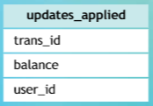
User
Transaction
Queue

Slide 74
Update A
Update B
User
Transaction
Queue

Slide 75
User
Transaction
Queue
Updated A
Updated B

Slide 76
Begin transaction
Insert into transaction(id, seller_id, buyer_id, amount);
Queue message “update user(“seller”, seller_id, amount)”;
Queue message “update user(“buyer”, buyer_id, amount)”;
End transaction
For each message in queue
Peek message
Begin transaction
If message.type == “seller”
Update user set amt_sold = amt_sold + message.amount where id=message.id;
Else
Update user set amt_bought= amt_bought + message.amount where id=message.id;
End if
End transaction
If transaction successful
Remove message from queue
End if
End for

Slide 77
Begin transaction
Insert into transaction(id, seller_id, buyer_id, amount);
Queue message “update user(“seller”, seller_id, amount)”;
Queue message “update user(“buyer”, buyer_id, amount)”;
End transaction
For each message in queue
Peek message
Begin transaction
Select count(*) as processed From updates_applied where
trans_id = message.trans_id and
balance = message.balance and
user_id = message.user_id
If processed == 0
If message.balance == “seller”
Update user set amt_sold = amt_sold + message.amount where id=message.id;
Else
Update user set amt_bought= amt_bought + message.amount where id=message.id;
End if
Insert into updates_applied (message.trans_id, message.balance, message.user_id);
End if
End transaction
If transaction successful
Remove message from queue
End if
End for

Slide 78
User
Transaction
Partition Tolerant
Basically Available
Soft State
Eventually Consistent
Queue

Slide 79
Can updates be idempotent?
2 X 1 = 2
X = 10
Arithmetic updates
X = X +10
Multiple updates, order is involved
X = 10
X = 20

Slide 80
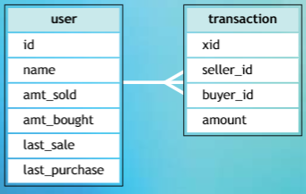
For each message in queue
Peek message
Begin transaction
Update user set last_purchase=message.trans_date
where id=message.buyer_id and last_purchase = message.trans_date;
End transaction
If transaction successful
Remove message from queue
End for

Slide 81
last_sale = t ms
last_sale = t+1 ms
last_sale = t ms
For each message in queue
Peek message
Begin transaction
Update user set last_purchase=message.trans_date
where id=message.buyer_id and last_purchase = message.trans_date
End transaction
If transaction successful
Remove message from queue
End for
last_sale = t+1 ms
last_sale = t ms
last_sale = t+1 ms

Slide 82
last_sale = t ms
last_sale = t+1 ms
last_sale = t ms
For each message in queue
Peek message
Begin transaction
Update user set last_purchase=message.trans_date
where id=message.buyer_id and last_purchase < message.trans_date;
End transaction
If transaction successful
Remove message from queue
End for
last_sale = t+1 ms
last_sale = t ms
last_sale = t+1 ms

Slide 83
More about
Soft State
&
Eventual Consistency

Slide 84
Soft State/Eventually Consistent
Soft State: The state of the system could change without applications interactions due to eventual consistency.
Without seeing inputs if a node changes its state then it is called soft state.
Eventual Consistency: The system will be eventually consistent after the application input.
The data will be replicated to different nodes and will eventually reach a consistent state. But the consistency is not guaranteed at a transaction level.

Slide 85
NodeA
X = 0
NodeB
X = 0
Database Interface
Tx Coordinator

Slide 86
NodeA
X = 0
NodeB
X = 0
Database Interface
Tx Coordinator
Write X = 1

Slide 87
NodeA
X = 0 1
NodeB
X = 0
X = 1
Database Interface
Tx Coordinator

Slide 88
NodeA
X = 1
NodeB
X = 0
Database Interface
Tx Coordinator
Read x

Slide 89
NodeA
X = 1
NodeB
X = 0
Read X
Database Interface
Tx Coordinator

Slide 90
NodeA
X = 1
NodeB
X = 0
Database Interface
Tx Coordinator
X=0

Slide 91
X = 1
NodeA
X = 1
NodeB
X = 0 1
Eventually Consistent
Database Interface
Tx Coordinator

Slide 92
NodeA
X = 1
NodeB
X = 1
Database Interface
Tx Coordinator
Read X

Slide 93
NodeA
X = 1
NodeB
X = 1
Read X
Database Interface
Tx Coordinator

Slide 94
NodeA
X = 1
NodeB
X = 1
Different replies, even though no updates in between : Soft State
Database Interface
Tx Coordinator
X=1

Slide 95
As software engineers we tend to look at our systems as closed loops.
There is a necessity for creating a correct software systems in terms of predictable inputs produce predictable outputs.
The good news in many cases is that using BASE doesn’t change the predictability of a system as a closed loop, but it does require looking at the behavior in total.
A simple example is given in the next slide to understand this point.

Slide 96
Consider a system where users can transfer assets to other users and the type of asset is irrelevant.
Assume that the two operations of taking the asset from one user and giving it to other user are decoupled
This system feels nondeterministic and problematic.
There is a period of time where the asset has left one user and has not arrived at the other. The size of this time window can be determined by the messaging system design

Slide 97
Event-Driven Architecture
what if you need to notify the user that the asset has arrived?
Creating an event within the transaction that commits the asset to the receiving user provides a mechanism for performing further processing once a known state has been reached
EDA (event-driven architecture) can provide dramatic improvements in scalability and architectural decoupling.

Slide 98
Conclusion
The traditional transactional models are problematic when loads need to be spread across a large number of components.
Decoupling the operations and performing them in turn provides for improved availability and scale at the cost of consistency

